Slide 1
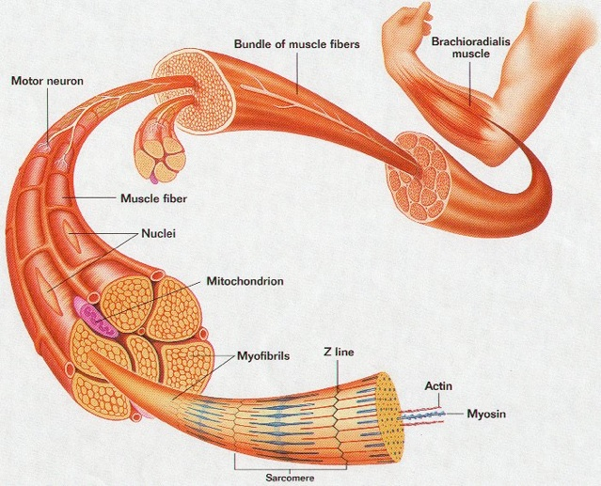
Structure of Skeletal Muscles
MMHS Anatomy and Physiology
Chitraroff

Slide 2
Fascia
Fascia separates muscles from each other.
A type of Loose Connective Tissue
Fascia may extend beyond the muscle to form tendons.
Fascia may form fibrous sheets called Aponeuroses. (ex. Lumbodorsal Fascia)
Fascia that closely surrounds one specific muscle is called epimysium. (epi = outside of)

Slide 3
Skeletal Muscle Organization
Each muscle is made of smaller bundles called fascicles (sing. Fasciculus).
Each fasciculus is surrounded by connective tissue called perimysium. (peri = surrounds)
Fasciculi contain individual muscle cells called fibers surrounded by connective tissue called endomysium. (endo = inside)
Each muscle fiber is further divided into myofibrils that may extend down the entire length of the muscle cell.

Slide 4
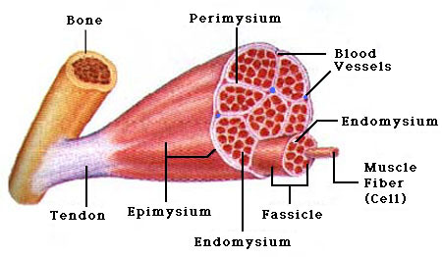
Skeletal Muscle Anatomy

Slide 5
Muscle Myofilaments
Each myofibril contains 2 types of protein myofilaments. (myo = muscle)
Actin = thin myofilament
Myosin = thick myofilament
→ Collectively, these make up a functional muscle unit called a Sarcomere.
Myofilaments form the sarcomere = the basic unit of muscle that is responsible for muscle contraction.

Slide 6
The Sarcomere : The Functional Muscle Unit
One sarcomere extends from Z-Line to Z-Line.
Each Z-Line provides a point of attachments for actin myofilaments.
Myosin myofilaments are located between each actin myofilament.
I-Band = Actin Only in this region.
A-Band = where Actin and Myosin overlap.
H-Zone = myosin only.
→ See Sarcomere Diagram (Fig. 6.3 on p. 183)

Slide 7
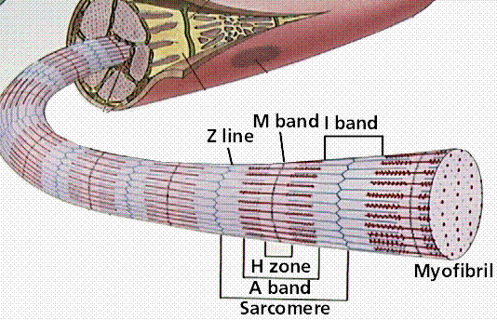
The Sarcomere

Slide 8
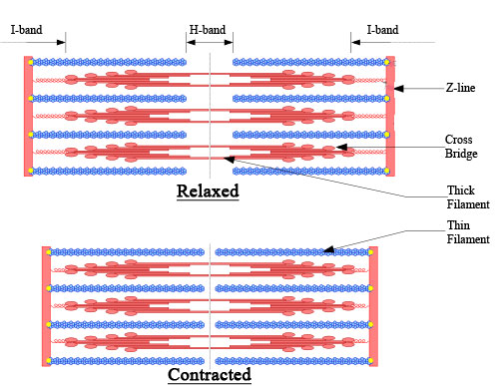
The Sarcomere

Slide 9
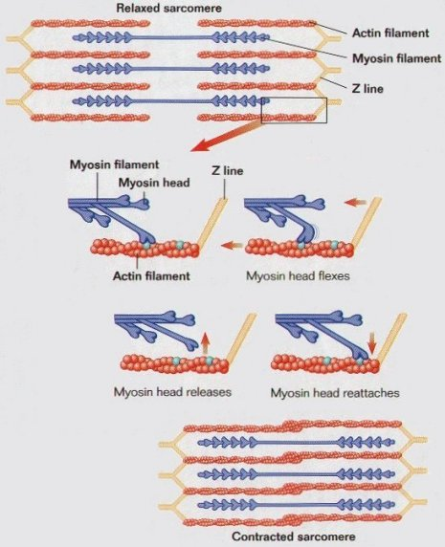
The Muscle Contraction

